Slide 1
Poverty measurement: Consumption Aggregate

Slide 2
Outline
General Concepts
What is welfare/poverty?
Why measure welfare/poverty?
How do we measure welfare/poverty?
Consumption Aggregate
Theoretical principles
Main components
Food
Non-food items
Housing
Durables

Slide 3
I. Concepts
General Concepts

Slide 4
Approaches to measuring welfare
Welfarism
Rooted in utilitarianism (Jeremy Bentham, John Stuart Mill): Social welfare should be judged by the aggregation of individual utilities
Takes individual utilities, based on the choices that people make
Depends on command over commodities, although preference over commodities may vary
Assumes that each person is a rational actor making optimal choice to maximize his/her utility
Imposes no value judgment (non paternalistic)
Capabilities
“Utility” as the sole measure of welfare is rejected
What people value intrinsically are the capabilities to function (“beings” and “doings” of life)
Social needs
Personal command over commodities is not a sufficient determinant of welfare. People’s needs depend on social context.
Related to the idea of relative deprivation
Consistent with welfarist and capability approaches

Slide 5
What is poverty?
“Poverty can said to exist in a society when one or more persons do not attain a level of material well-being deemed to constitute a reasonable minimum by the standards of that society” (Ravallion, 1994)
How do we calculate the “level of material well-being” attained by a person?
What is the “reasonable minimum” of a society?
How do we compile individual information into an aggregate measure of poverty?
Different definitions
…from narrow approaches…
lack of specific consumptions (e.g. too little food energy intake; too little leisure)
…to broader…
Poverty is the lack of “well-being” (e.g. lack of “capabilities”: inability to achieve certain “functionings” (“beings and doings”- Amartya Sen)→ Multidimensional approach
Poverty is a complex and multidimensional phenomenon

Slide 6
Why measure poverty?
Inform program design
Who are the target groups?
How should transfers be allocated?
How much impact will they have on poverty?
Monitor progress
Has poverty increased? Did growth help the poor?
Foster evidence-based policy making
Who were the losers and winners from economy-wide policy reforms? (ex-ante vs. ex-post)
Who benefits from government subsides? Who will be hurt by retrenchment?
But…can also be used to misinform

Slide 7
How do we measure poverty?
Poverty measurement involves 3 steps:
Identify the “space” in which poverty is going to be measure
We will use consumption as the welfare measure

Slide 8
The “space”: Income vs. Consumption
Welfare Aggregate | Pros | Cons
Income | Easy to measure for regular salaried workers Measures degree of household “command” over resources Linkage with Sen’s functionality | Concerns about underreporting May be affected by short-term fluctuations Difficult to monitor revenues and costs for farmers and self-employers in the informal sector Effects of saving Reporting period might not capture the “average” income of the household
Consumption | Shows current actual material standard of living Smoothens out irregularities, and so reflects long-term average well-being Often not related to tax Better linkage with utility theory | Need various adjustments Some expenses are not incurred regularly, so data may be noisy Difficult to measure some components of consumption, including durable goods and housing rents Expenditures on “bads”

Slide 9
Other possible measures of household welfare
Calories consumed per person per day
Food consumption as a fraction of total consumption
Nutritional and anthropometric measures
Self-assessed welfare

Slide 10
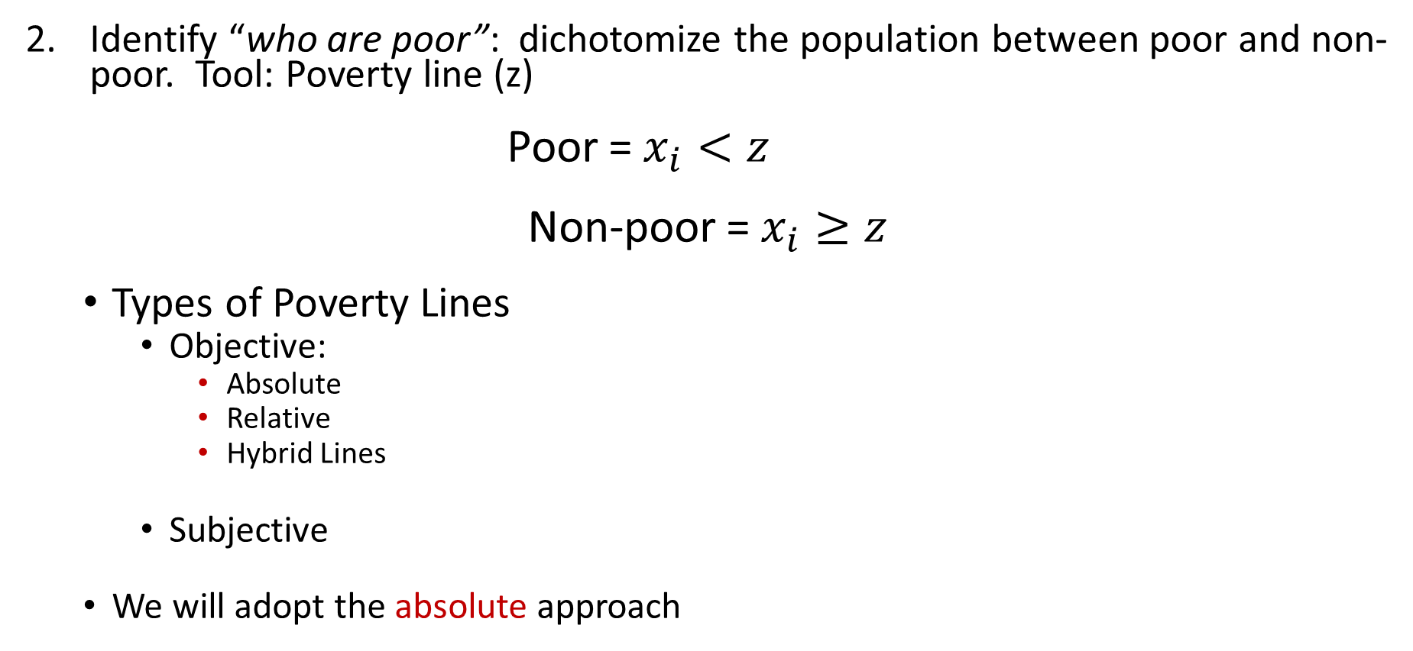
How do we measure poverty?
Identify “who are poor”: dichotomize the population between poor and non-poor. Tool: Poverty line (z)
Poor = $x_{i}<z$
Non-poor = $x_{i}≥z$
Types of Poverty Lines
Objective:
Absolute
Relative
Hybrid Lines
Subjective
We will adopt the absolute approach
Notes:
Objective approach:
Absolute: Poverty line is defined based on the cost of attaining a basic standard of living and is anchored to nutritional requirements
Relative: Poverty line is defined relative to average income or consumption (i.e. some percentage of the mean or median level)
Hybrid Lines: Combinations of absolute and relative lines. Examples: Foster (1998) $z=z_{b}^{ρ}z_{a}^{(1−ρ)}$and Ravallion & Chen (2010) $z=max⁡(z_{a},α+kM)$ with M = median income
Subjective approach
Poverty line calibrated to subjective poverty status

Slide 11
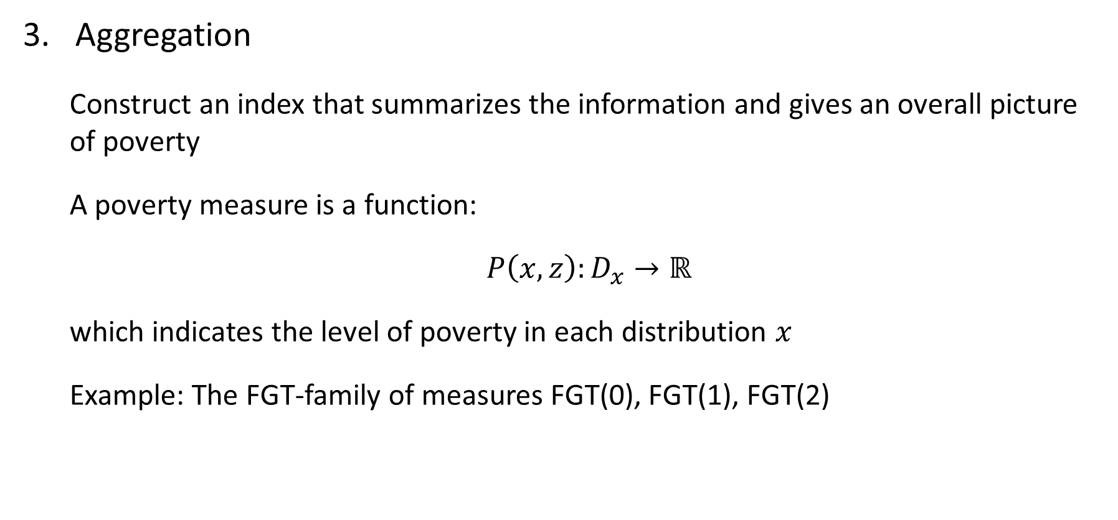
How do we measure poverty?
Aggregation
Construct an index that summarizes the information and gives an overall picture of poverty
A poverty measure is a function:
$P\left(x,z\right):D_{x}→ℝ$
which indicates the level of poverty in each distribution $x$
Example: The FGT-family of measures FGT(0), FGT(1), FGT(2)

Slide 12
How do we measure poverty?
A welfare measure for individuals, used to derive a distribution of living standards
A poverty line, threshold below which individuals are classified as poor
A poverty measure, summary statistics of poverty in population
Density
Welfare Indicator

Slide 13
II. Consumption Aggregate
Consumption Aggregate

Slide 14
Outline
Theoretical principles
Main components
Food items
Non-food items
Housing
Durables

Slide 15
Constructing the consumption measure
The consumption measure is the foundation over which all poverty analysis rests
Principles
As comprehensive as possible
Transparent and plausible
Goal is to rank individuals/households
Important clarifications
Consumption: destruction of goods and services by use
Expenditure: consumption valued at prices paid
Income: maximum possible expenditure on consumption without depleting assets

Slide 16
Utility consistent welfare indicator
Economic theory is based on a (rather philosophical) assumption that an individual makes a choice to maximize his or her utility
Utility is a subjective experience of “happiness” or “satisfaction” or “fulfillment”
Ravallion (1994) constructs a poverty measurement framework that is consistent with the utility theory
This approach needs a welfare indicator which increases if and only if utility increases
Money-metric of utility: A monetary measure of welfare that is consistent with the concept of utility

Slide 17
Theory of Consumer Choice
X
Consumers maximize utility subject to budget constraint
Consumers cannot alter the market price
More of either good is better (non-satiation principle)
Indifference curve is usually assumed to be convex
The amount of good X needed to compensate for giving up one unit of good Y to keep utility constant (marginal rate of substitution) is high when Y is low
At point E’, MRS = relative price of X and Y
Budget
Line
X’
E’
U’
Y’
Y

Slide 18
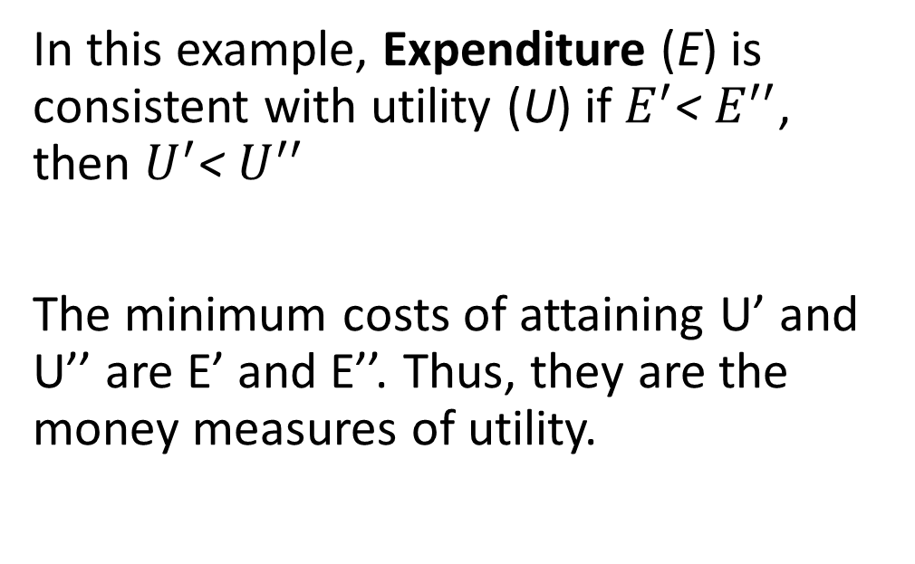
Expenditure as a utility consistent welfare indicator
X
In this example, Expenditure (E) is consistent with utility (U) if $E^{′}$< $E^{′′}$, then $U^{′}$< $U^{′′}$
The minimum costs of attaining U’ and U’’ are E’ and E’’. Thus, they are the money measures of utility.
E’’
X’
E’
U’’
U’
Y’
Y

Slide 19
If the price of X declines…
X
With the same expenditure, one can achieve a higher level of utility. Expenditure is no longer utility consistent
E’= E_{n} but U’ < U_{n}
X_{n}
X’
U_{n}
U’
Y_{n}
Y’
E’=E_{n}
Y

Slide 20
Restore utility consistency of expenditure
X
Evaluate the (X_{n},Y_{n}) at the new price levels;
Calculate a new expenditure level E*;
Compare E* and E’
U’ < U_{n} and E’ < E*
X_{n}
X’
U_{n}
U’
Y_{n}
Y’
E’=E_{n}
E*
Y

Slide 21
When expenditure is utility consistent
Expenditure is utility consistent if the following conditions are satisfied:
All individuals have the same utility function
Prices are identical to all individuals
All household and individual characteristics are the same
All individuals have exactly the same goods that are not transacted in markets
If not, you need to do make adjustments to make expenditures comparable across individuals

Slide 22
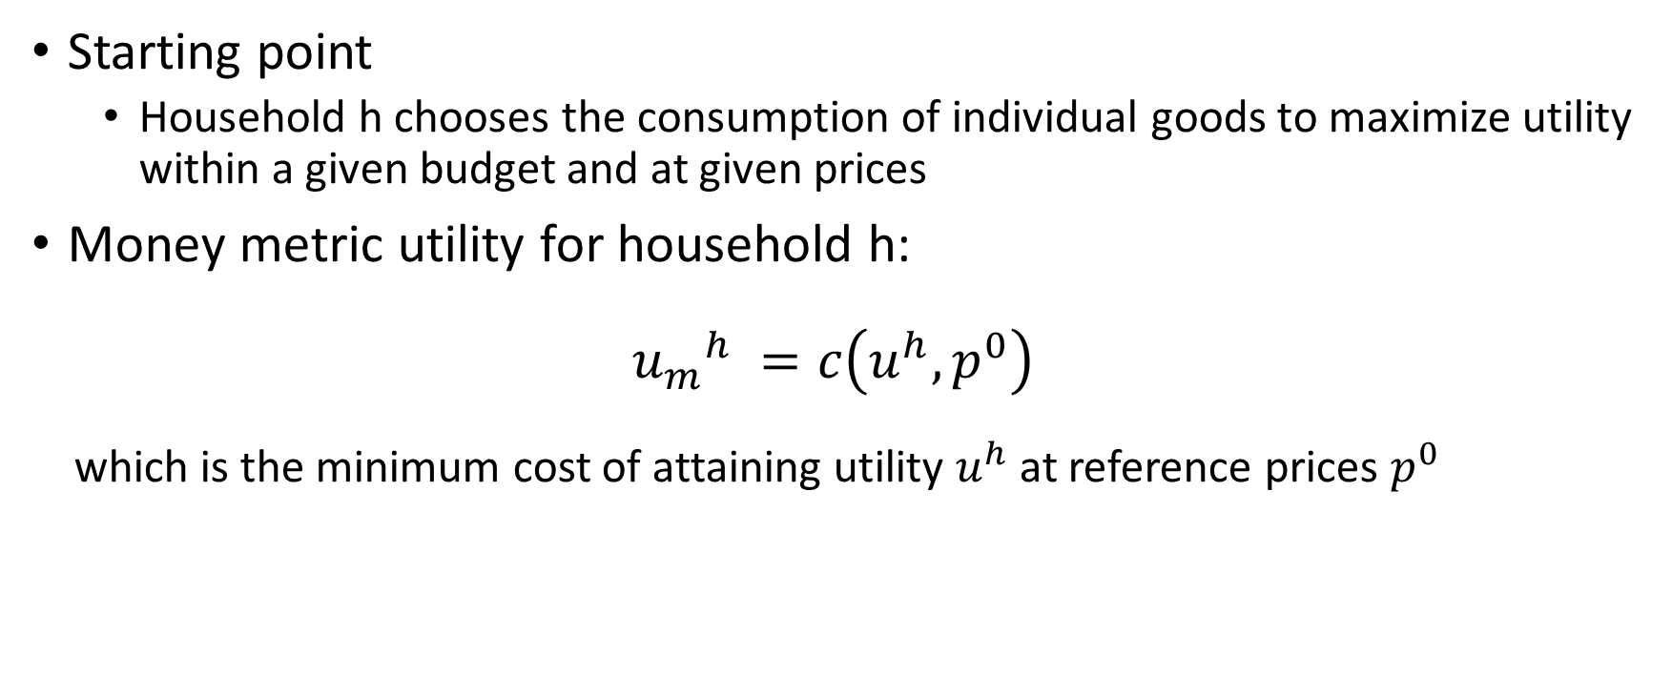
Conceptual framework
Starting point
Household h chooses the consumption of individual goods to maximize utility within a given budget and at given prices
Money metric utility for household h:
$${u_{m}}_{}^{h}=c\left(u^{h},p^{0}\right)$$
which is the minimum cost of attaining utility $u^{h}$ at reference prices $p^{0}$

Slide 23
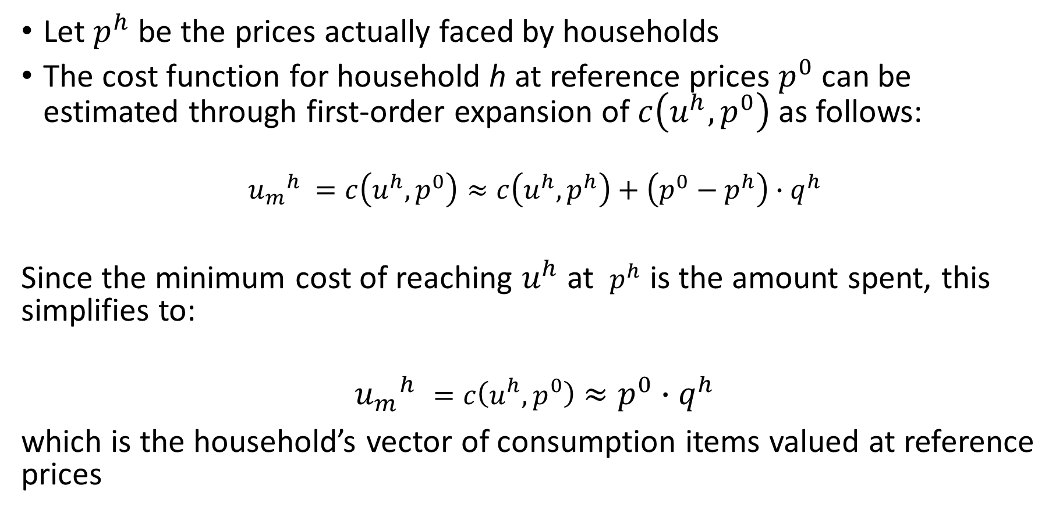
Conceptual framework
Let $p^{h}$ be the prices actually faced by households
The cost function for household h at reference prices $p^{0}$can be estimated through first-order expansion of $c\left(u^{h},p^{0}\right)$as follows:
${u_{m}}_{}^{h}=c\left(u^{h},p^{0}\right)≈c\left(u^{h},p^{h}\right)+\left({p^{0}−p}^{h}\right)∙q^{h}$
Since the minimum cost of reaching $u^{h}$ at $p^{h}$ is the amount spent, this simplifies to:
$${u_{m}}_{}^{h}=c\left(u^{h},p^{0}\right)≈p^{0}∙q^{h}$$
which is the household’s vector of consumption items valued at reference prices

Slide 24
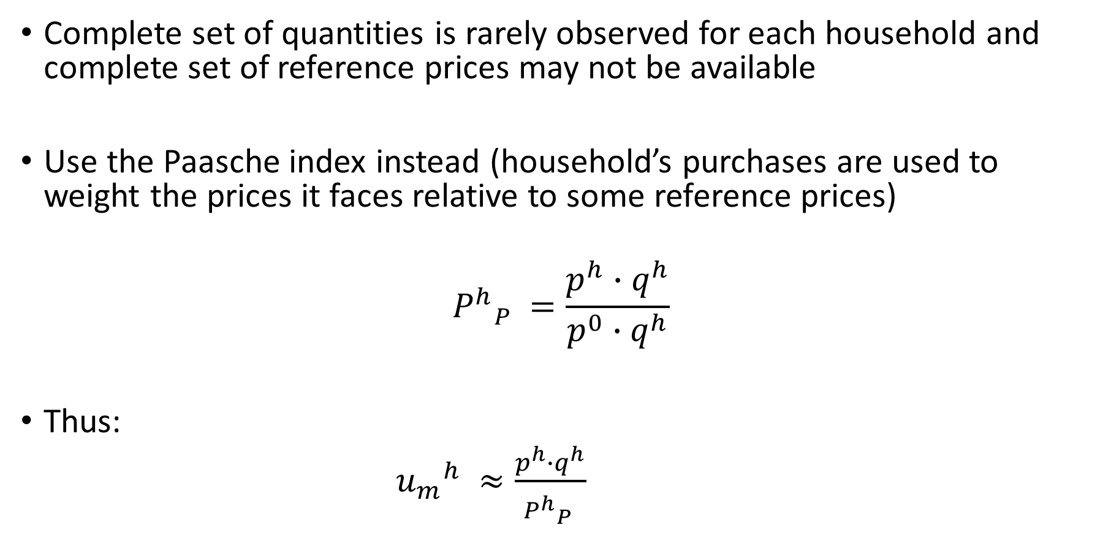
Conceptual framework
Complete set of quantities is rarely observed for each household and complete set of reference prices may not be available
Use the Paasche index instead (household’s purchases are used to weight the prices it faces relative to some reference prices)
$${P^{h}}_{P}^{}=\frac{p^{h}∙q^{h}}{p^{0}∙q^{h}}$$
Thus:
${u_{m}}_{}^{h}≈\frac{p^{h}∙q^{h}}{{P^{h}}_{P}^{}}$

Slide 25
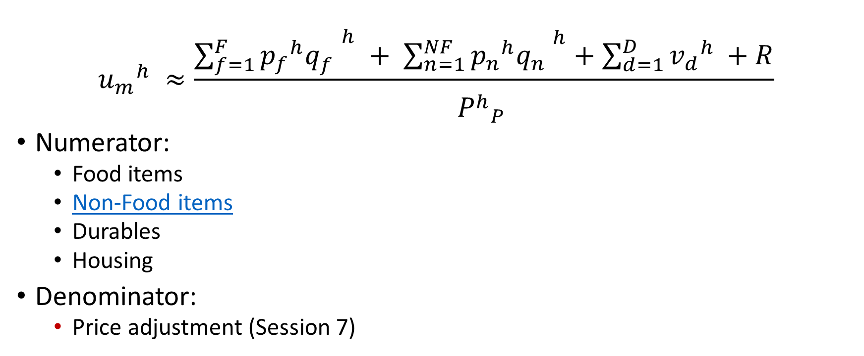
Conceptual framework
$${u_{m}}_{}^{h}≈\frac{\sum_{f=1}^{F}{{p_{f}}^{h}{q_{f}^{}}^{h} + \sum_{n=1}^{NF}{{p_{n}}^{h}{q_{n}^{}}^{h}+\sum_{d=1}^{D}{{v_{d}}_{}^{h}+R}}}}{{P^{h}}_{P}^{}}$$
Numerator:
Food items
Non-Food items
Durables
Housing
Denominator:
Price adjustment (Session 7)

Slide 26
Conceptual framework
Heterogeneity in welfare-relevant non-market characteristics is a threat to interpersonal comparisons
Utility people derive from a given consumption bundle differs based on personal/household characteristics:
Household size
Demographic composition
Prices
Health and disability
Access to non-market goods (public services, environmental characteristics)
More of certain market goods may be needed to attain the same level of utility

Slide 27
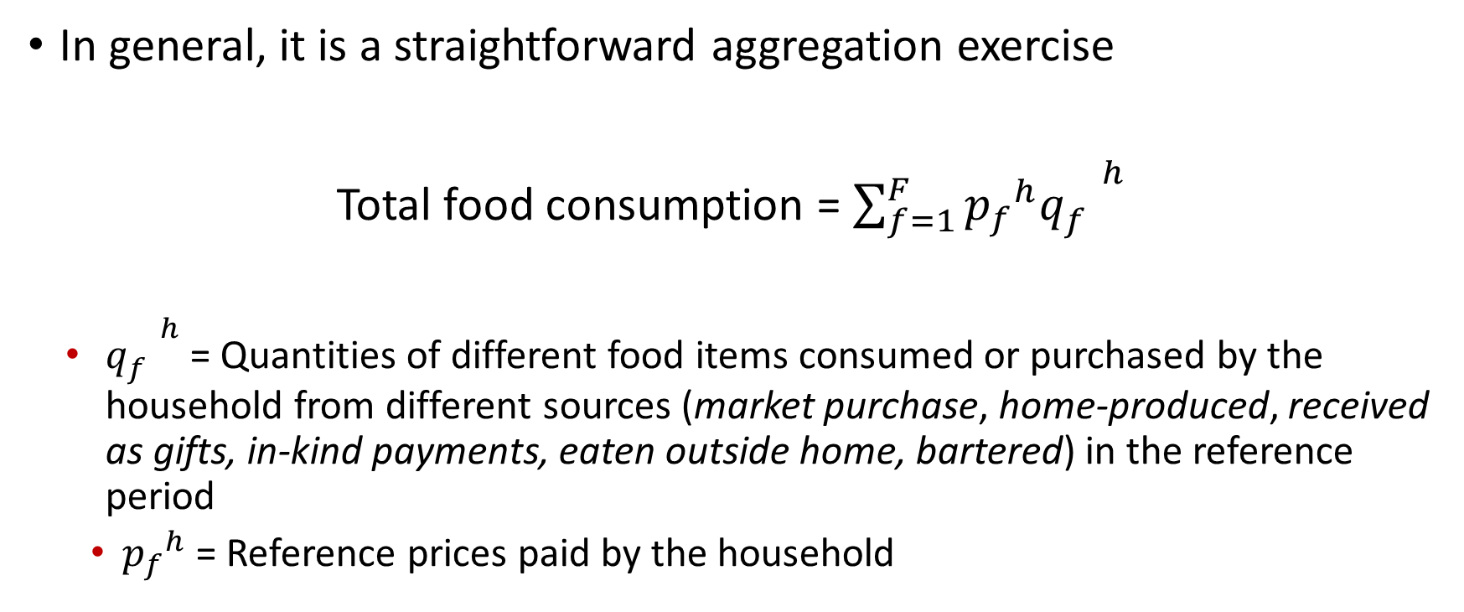
Food Items
In general, it is a straightforward aggregation exercise
Total food consumption = $\sum_{f=1}^{F}{{p_{f}}^{h}{q_{f}^{}}^{h} }$
${q_{f}^{}}^{h}$ = Quantities of different food items consumed or purchased by the household from different sources (market purchase, home-produced, received as gifts, in-kind payments, eaten outside home, bartered) in the reference period
${p_{f}}^{h}$ = Reference prices paid by the household

Slide 28
Food Items
Issues in valuation of food expenditure
Reference period
No market price
Food away from home
Notes:
A household that stocks up on an item once every few months, and whose purchase is caught by the survey, should not be counted as well-off, nor should someone who did not stock up in the survey period be counted as poor

Slide 29
Food Items
Valuation Problem: Reference period
Surveys vary in terms of reference periods
Longer reference: reduces problems of seasonality or infrequent expenditure but suffers from memory decay
Captures the purchase of low-frequency items by households in the lower parts of the distribution
Shorter reference: likely more accurate recall but misses purchases made outside the short reference period and may be subject to telescoping errors
The direction of bias in aggregate consumption and poverty rate in longer or shorter recall period is ambiguous a priori
Notes:
A household that stocks up on an item once every few months, and whose purchase is caught by the survey, should not be counted as well-off, nor should someone who did not stock up in the survey period be counted as poor

Slide 30
Food Items
The Great Indian Poverty Debate (Deaton and Kozel, 2005):
Uniform Reference Period (URP) until 1993-94: 30-day recall for all items
Mixed Reference Period (MRP) introduced in the 1999-2000 round:
Expenditure on food, pan, and tobacco by 7-day and 30-day recall
Expenditure of clothing, footwear, durable goods, education expenses, and institutional medical expenses by 365-day recall
Modified Mixed Recall Period (MMRP) introduced in the 2011-12 round:
7-days for perishable items
365-days for 5 low-frequency items
30 days for the remaining items
Notes:
A household that stocks up on an item once every few months, and whose purchase is caught by the survey, should not be counted as well-off, nor should someone who did not stock up in the survey period be counted as poor

Slide 31
Food Items
The Great Indian Poverty Debate (Deaton and Kozel, 2005):
Uniform Reference Period (URP) until 1993-94: 30-day recall for all items
Mixed Reference Period (MRP) introduced in the 1999-2000 round:
7-days and 30-days for expenditure on high-frequency items (food, pan, and tobacco). Higher monthly expenditure with 7-day recall.
365-days for expenditure of low-frequency items (clothing, footwear, durable goods, education expenses, and institutional medical expenses). Decrease in mean expenditure but expenditure reported by households in the bottom tail.
30-days for the remaining items
Modified Mixed Recall Period (MMRP) introduced in the 2011-12 round:
7-days for perishable items
365-days for 5 low-frequency items
30 days for the remaining items
Notes:
A household that stocks up on an item once every few months, and whose purchase is caught by the survey, should not be counted as well-off, nor should someone who did not stock up in the survey period be counted as poor

Slide 32
Food Items
The Great Indian Poverty Debate (Deaton and Kozel, 2005):
Official poverty rates:
1993/1994 = 36%
1999/2000 = 26% (Uses 30-day recall for high frequency items but its reporting could be biased due to the existence of 7-day recall)
Official 2004-05 poverty rate:
URP-based data = 27.5%
MRP-based data = 21.8%
Notes:
A household that stocks up on an item once every few months, and whose purchase is caught by the survey, should not be counted as well-off, nor should someone who did not stock up in the survey period be counted as poor

Slide 33
Food Items
Valuation problem: No market price
There are food items “consumed” or “purchased” and no prices → how do we value them?
We can use different sources of price information:
External sources
CPI mostly collected in urban areas or capital city
Internal sources
Price surveys
Unit values

Slide 34
Food Items
Price surveys collected from markets
Community Prices Surveys | Uncommon practice Unreliable due to wrong markets or specification of prices not actually paid by local residents (bargaining or interaction)
Price Opinion | Interview of key informants Photos of variety of different items Asked every sampled household Not tied to actual purchasing behavior

Slide 35
Food Items
Unit Values: Ratio of value (expenditure) to quantity
Non-diary questionnaire | Advantages | Representative at subnational level Related to actual transactions
 | Disadvantages | Represent both prices and quality Sampling variation Measurement error (Recall period or unit of measure)
Diary questionnaire | Advantages | Similar to non-diary and seem to be closer to market prices (capture differences in qualities)
 | Disadvantages | Means of acquisition (purchases; gifts; own production) may not be clear Non-response could be high due to survey burden

Slide 36
Food Items
Valuation problem: Home-produced food items
Market price from food purchases section
“Farm-gate” prices:
Households’ own valuation of the amount they would expect to receive (pay) if they had sold (bought) the item or
Need to value only the portion of production kept for household consumption:
Agriculture production questionnaire: “How much of the …[crop]…did the household keep for consumption at home?”

Slide 37
Food Items
Valuation problem: Ration items
Principle
Households that consume the same amount of a ration item are assigned the same expenditure and, thereby, utility
Expenditure increases with consumption of an item (Krishna et al, 2016)
Which price?
Official prices for ration items
Self-reported market price of ration items: “What price would you pay in the market to buy [ITEM] of the same quality?”
Market price of ration reported by ration agents (akin to price survey)
Price of the closest item traded in the market

Slide 38
Food Items
Valuation problem: Food consumed outside of home
The consumption of food outside the home is rapidly growing across the developing world
Percentage of households reporting meals outside the home increased from
20% to 46% in Egypt between 1981 and 1998
23% to 39% in India between 1994 and 2010
Household per capita expenditure on food away from home rose at an annual rate of 9.5% in China from 2002 to 2011
Most income/expenditure surveys collect very limited information on food away from home (FAFH)
Source: Farfan and Vakis (2017)

Slide 39
Food Items
Valuation problem: Food consumed away from home
The consumption of food outside the home is rapidly growing across the developing world
Percentage of households reporting meals outside the home increased from
20% to 46% in Egypt between 1981 and 1998
23% to 39% in India between 1994 and 2010
Total expenditure on food away from home in urban China rose 63 percent between 1995 and 2001
Most income/expenditure surveys collect very limited information on food away from home (FAFH)
The implications of not having FAFH on poverty and inequality is ambiguous since it affects both food consumption and poverty line
Source: Smith, Dupriez, Troubat (2014)

Slide 40
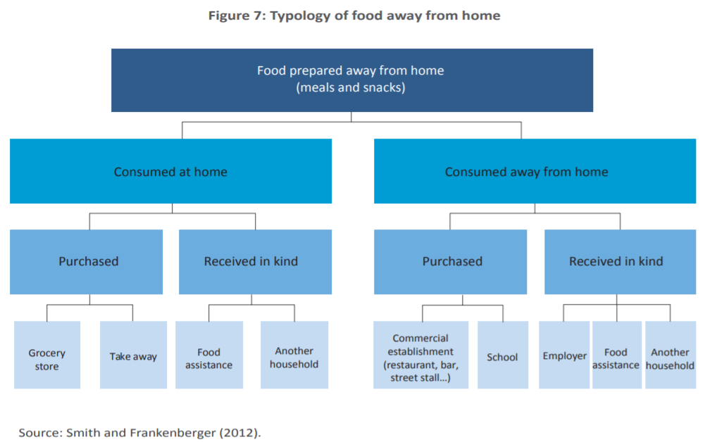
Food Items: Food consumed away from home

Slide 41
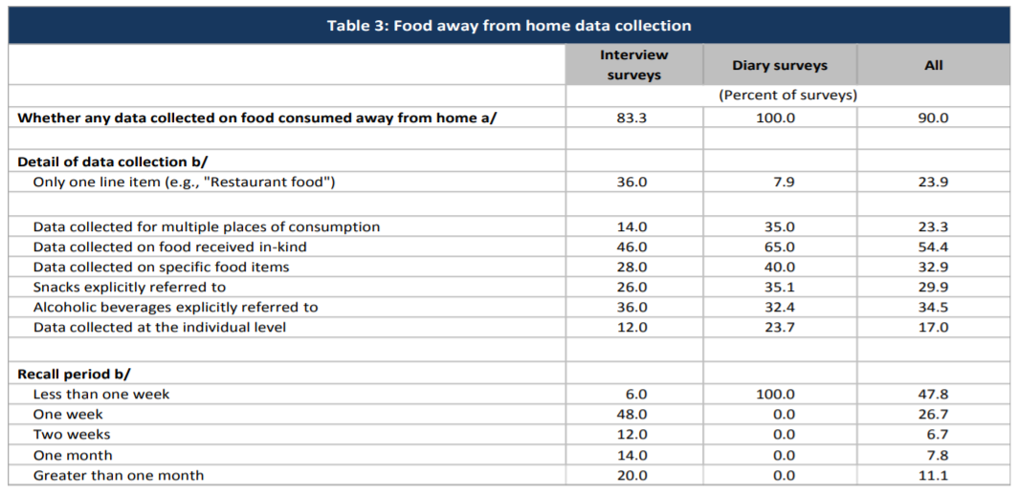
Food Items: Food consumed away from home

Slide 42
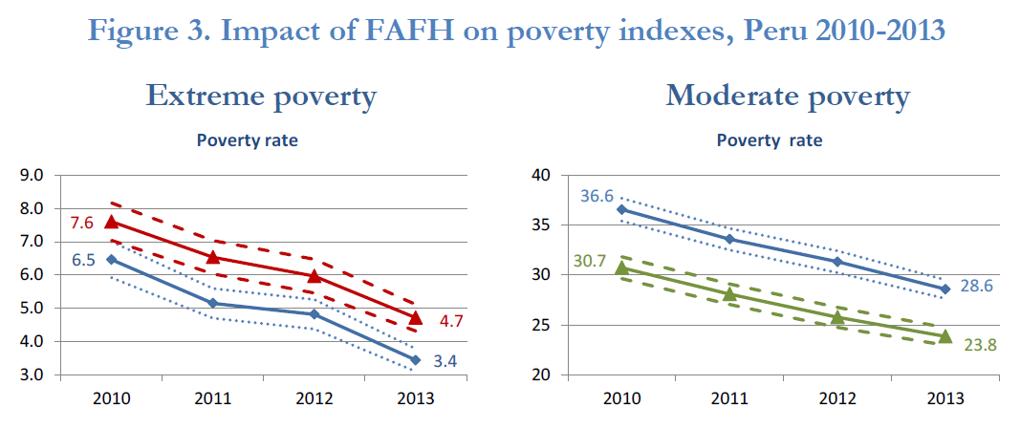
Food Items: Food consumed away from home
Source: Farfan, Genoni, and Vakis (2015)

Slide 43
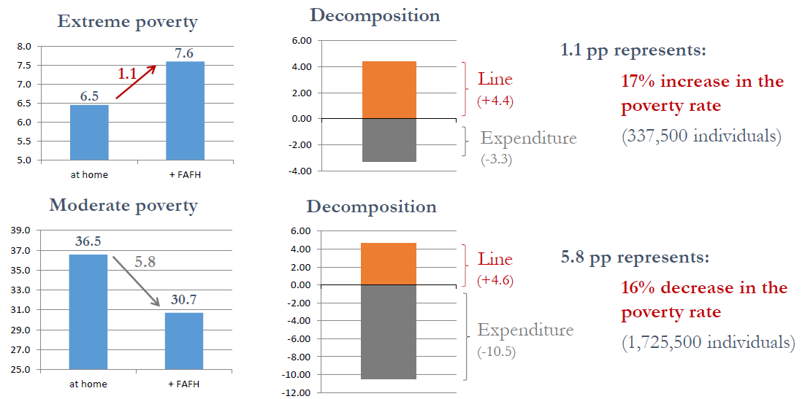
Food Items: Food consumed away from home
Source: Farfan and Vakis (2017)

Slide 44
Food items
Valuation problem: Food consumed away from home
Do we have to include these items?
Depends on how microdata are collected
… the amount is thoroughly collected and corresponding calories intake is available → include
But…this information is rarely collected → 90% of surveys consider food consumed away from home in some form and 25% of these surveys uses just one question

Slide 45
Non-food items
Wide range of non-food items
Collected on daily-use as well as other less frequent purchased items
Different reference periods often used to match with frequency of purchase
Computation is straightforward but difficulties in the choice of which items to include
“Unit values” of non-food goods is usually not calculated
In general include:
Frequently purchases goods and services (e.g. soap, cooking fuel, personal care, recreation, transport, supplies, etc.)
Less frequent but regularly purchased items (e.g. clothing, kitchen equipment, textiles, household items, etc.)

Slide 46
Non-food items
In general, exclude:
Avoid lumpy expenditure (i.e. large and infrequent: weddings, birth, funerals, among others)
Large occasional expenditures
Avoid items for which is hard to estimate accurately (i.e. public goods and leisure)
Avoid double-counting: transfers to other households
Remittances paid; gifts and transfers out
Investments
Business-related expenses but include own-consumption
Taxes paid; repayment of loans, interest payments, purchase of financial assets
Tradeoff between comprehensiveness and measurement error
Notes:
Taxes could argue for including local taxes if they bear strong relation to local services so households that are paying more taxes are receiving more services, are better off as a result and the inclusion of the tax will do something to capture the regional differences in public good provision between different households.

Slide 47
Non-food items
Health
These expenditures are generally excluded because…
They can be lumpy (i.e. large occasional expenditure)
It is not welfare-enhancing: inability to measure the loss of welfare associated with being sick which is ameliorated by health expenditures
But we miss the difference between sick individuals: one who can afford health care and other who can not
Elasticity of expenditure
Education
Can be lumpy
Can be considered as investment rather than consumption
However, these are not irregular as health expenditure (regular at a particular point in the life-cycle)

Slide 48
III. Treatment of Outliers
Treatment of Outliers

Slide 49
Outliers
How to deal with “gross” outliers?
There is no straightforward rule to follow except…
Paying attention to what data shows (i.e. maintain a “reasonable” dispersion) and
Magnitude of the change you are imposing with the correction method
Use more than one rule: graphs such as histograms and automatic corrections

Slide 50
Outliers
Not only isolated outliers but also groups of outliers
Units have been misinterpreted for instance, eggs measured in units for some households and dozens for others
Spatial disparities
If there are significant regional disparities across the country then correction must NOT be made at national level
Temporal disparities
Correcting quantities consumed by households independently of when they do it may squeeze the distribution

Slide 51
Outliers
Automatic rule example of detection of outliers
Eliminate those whose logarithm lie more than 2.5 standard deviations from the mean of logarithms
Again this DOES NOT remove the need for graphical inspection and reasonable judgment of the analyst

Slide 52
III. Treatment of Outliers
Thank you!

